Slide 1
Earnings and Age in Urban Balochistan
Variant 7
last two digits ÷ 8 leave 7
Evidence from the PSLM 2019–20 person file
Area
Balochistan, urban
Sample
486 earners aged 15–64
Weighting
Household weight (hhweight)
ECO346 Data Visualization Techniques for Economists
Assignment 1 | Section A
Dr. Rafi Amir-ud-Din
Notes:
Good morning. The last two digits of my registration number leave a remainder of 7 when divided by 8, so my variant is Balochistan urban. From the PSLM 2019-20 person file I kept people aged 15 to 64 with positive annual earnings: 486 earners. The person file has no weights, so I attached hhweight, province and area from the household file by hhid, and every number I show is weighted. (About 45 seconds.)

Slide 2
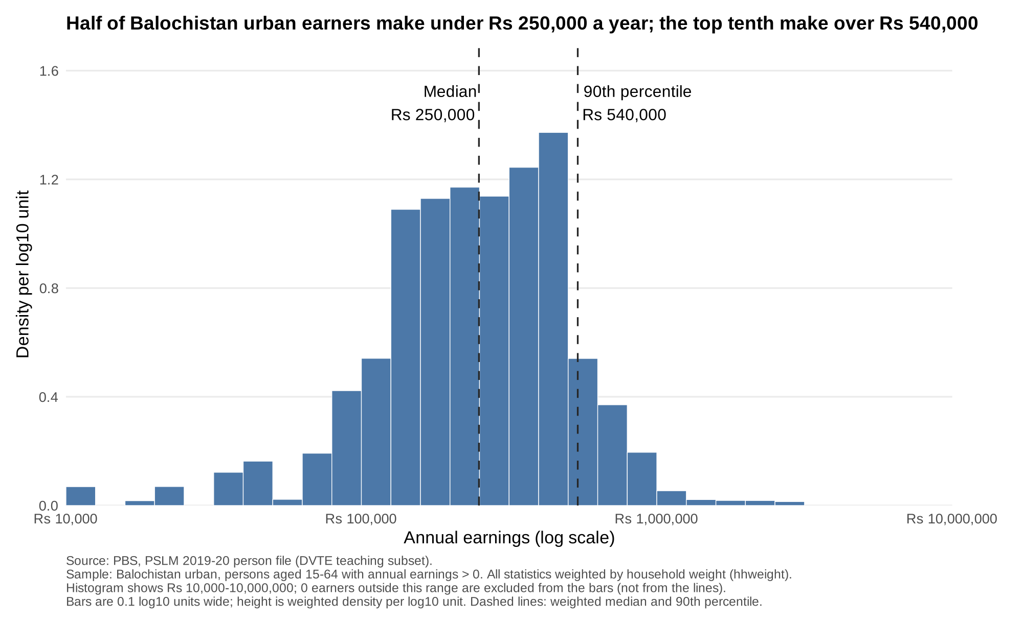
Half of urban Balochistan earners make under Rs 250,000 a year
Earners | 486
Weighted median | Rs 250,000
Unweighted median | Rs 264,000
Weighted P10 | Rs 96,000
Weighted P90 | Rs 540,000
P90 / P10 | 5.62
The weighted median is lower: over-sampled small districts here earn more, and weights shrink them back to their true size.
Notes:
This is a weighted histogram on a log scale, bins 0.1 log units wide, height is density per log10 unit so the bars' area adds to one. The axis is labelled in rupees. Most earners make between Rs 100,000 and Rs 600,000 a year. The weighted median is Rs 250,000; the 90th percentile is Rs 540,000, 5.62 times the 10th percentile of Rs 96,000. Here the weighted median is LOWER than the unweighted one, Rs 264,000. The subset over-samples small districts, and in urban Balochistan several of them earn more than average; one district is 5.8% of the sample but 0.5% of the population. Weights shrink them and give the large, lower-earning districts their true share. No earner falls outside the Rs 10,000 to 10 million range. (About 1 minute.)

Slide 3
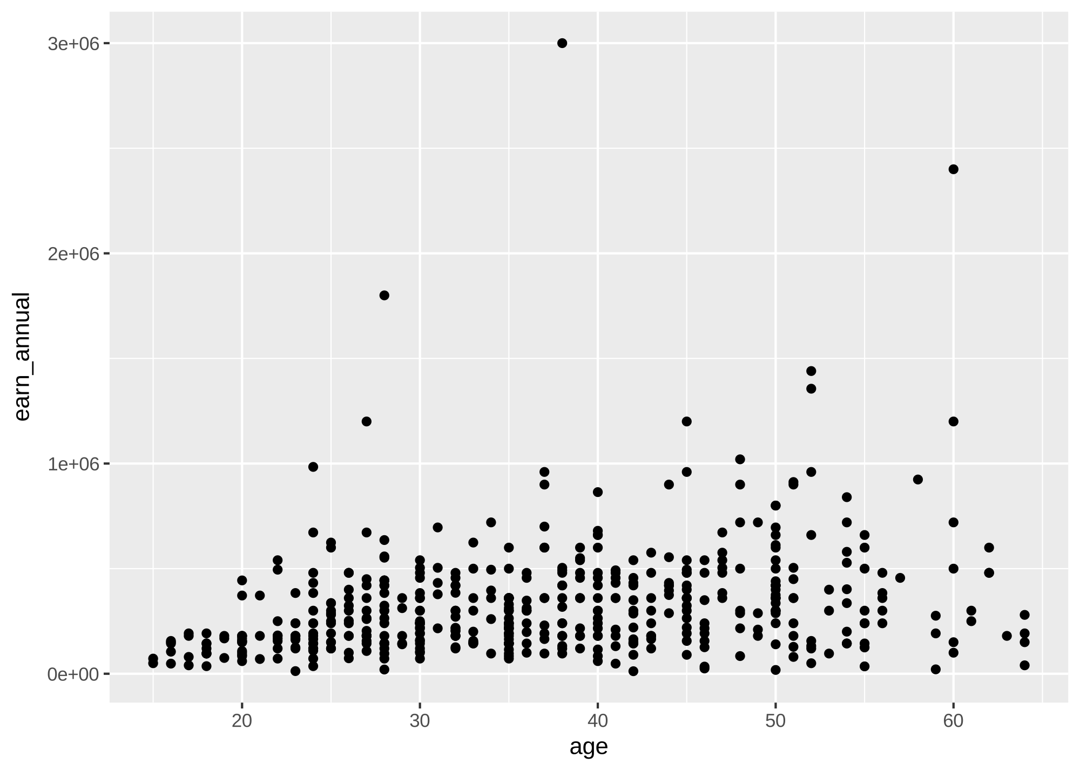
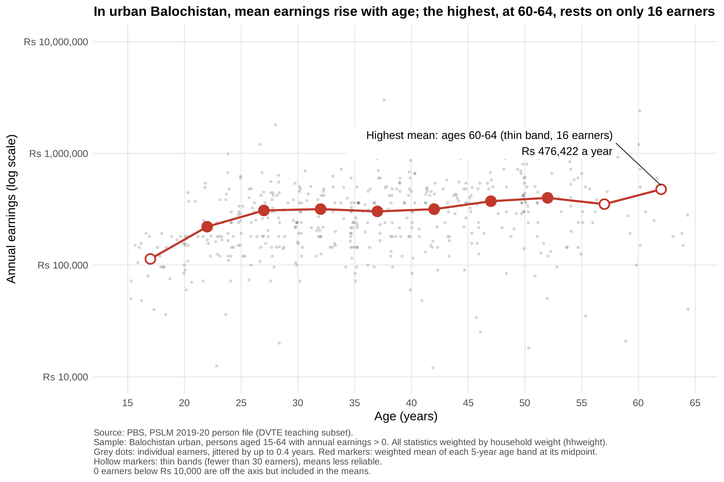
Makeover: R's default scatterplot and its redesign
Default
Redesign
1 Log scale in rupees, not 3e+06
2 Transparency + jitter reveal density
3 Weighted band means show the trend
Notes:
On the left is R's default. A few earners above Rs 1 million stretch the linear axis so almost every point is crushed into the bottom, labels read 3e+06 instead of rupees, and opaque dots at whole ages form solid strips. Four changes. One: a log scale labelled in rupees spreads proportional differences evenly. Two: alpha 0.2 and horizontal jitter of at most 0.4 years fix overplotting, so darkness shows density, including heaping at round figures. Three: weighted means for each five-year band, joined by a line, show the conditional mean, read by position on a common scale, the most accurate channel. Four: less non-data ink and a title that states the finding. What the default shows better: how far the very top earners are from everyone else in rupees. (About 1.5 minutes.)

Slide 4
Mean earnings rise with age, but the oldest bands are thin
Weighted mean earnings (Rs)
Ages 15–19 (thin) | 113,382
Ages 25–29 | 307,994
Ages 45–49 | 372,723
Ages 50–54 | 399,250
Ages 60–64 (thin) | 476,422
The 60–64 peak rests on only 16 earners; among well-sampled bands the peak is 50–54. Earnings plateau near Rs 300,000 from 25 to 44.
One survey year: different cohorts, not one person ageing.
Notes:
My main finding. Weighted mean earnings rise from Rs 113,382 at 15 to 19 to about Rs 308,000 at 25 to 29, stay roughly flat near Rs 300,000 to 317,000 until 44, then rise to Rs 399,250 at 50 to 54. The highest mean, Rs 476,422 at 60 to 64, is a thin band of only 16 earners, shown hollow, so I would not trust it as the peak; among bands with 30 or more earners the peak is 50 to 54. Hollow markers also flag 15 to 19 and 55 to 59. Within every band earnings vary hugely, so age explains little of who earns what, and as one survey year it compares cohorts, not one person ageing. The Python band table matches R to the rupee. Thank you. (About 1 minute.)

